Slide 1

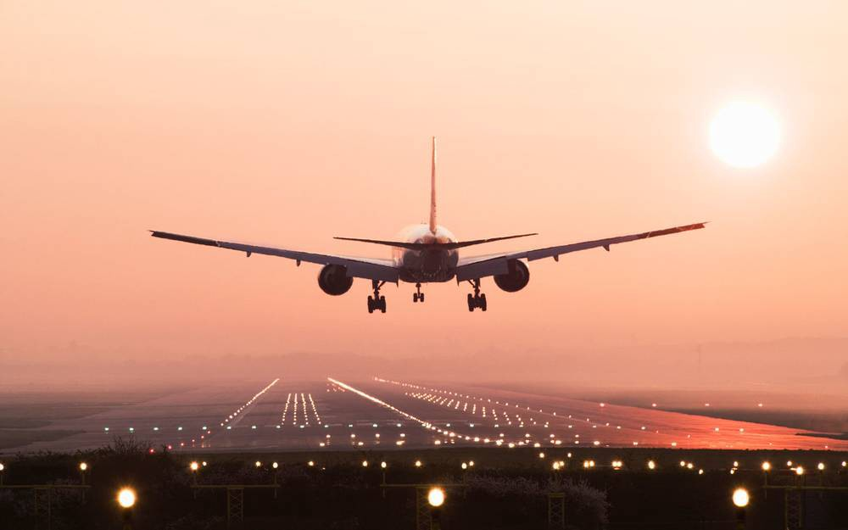
Project On: Flight Delay Analysis
Date:
24 Aug 2022
Team Members:
Ajay Anap
Pranav Singh
Suhas Malaji
Saritha

Slide 2
Project Objective
This project is based on Aviation Domain where client has to know some parameters regarding delay of flights. The data contains Three Datasets which are- airlines, airports. So to do some analysis on flight delay we created 4 KPI’s using –
i) Excel- Data cleaning, Pivot Table, use various functions like Vlookup, Filters.
ii) My SQL- Perform queries with syntax like Joins, Primary key, Alter table etc.
iii)Tableau & Power Bi- Perform visualizations to showcase the KPI’s in the form of Dashboard.

Slide 3
KPI’s to perform analysis:
KPI-1: Weekday vs Weekend total flights statistics
KPI-2: Total number of cancelled flights for JetBlue airways on first date of
every month.
KPI-3: Week wise, State wise and City wise statistics of delay of flights with
airline details.
KPI-4: Number of airlines with No departure / arrival delay with distance
covered between 2500 and 3000.

Slide 4
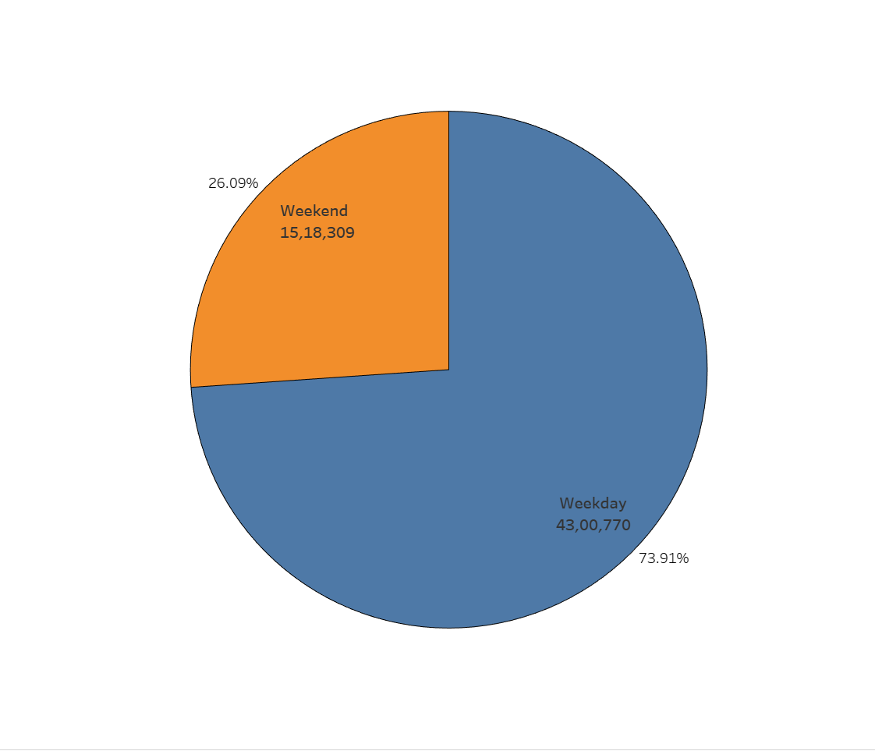
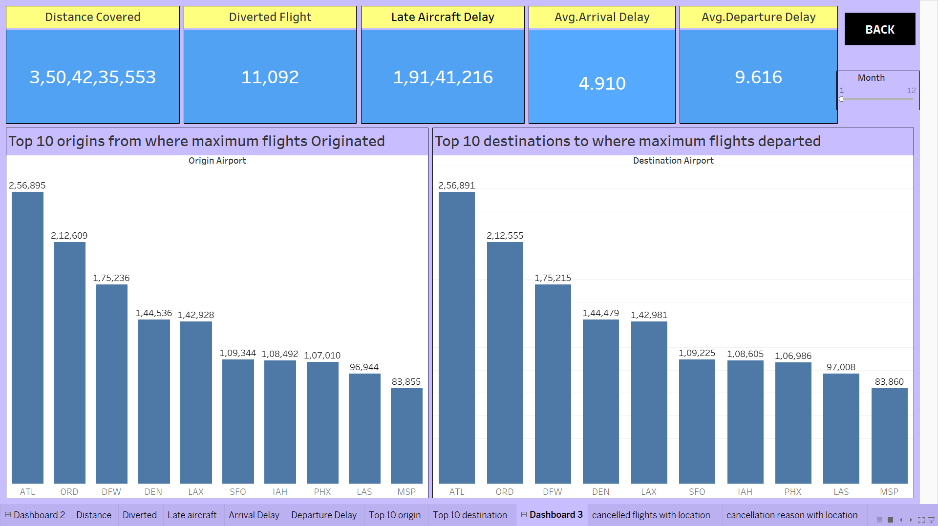
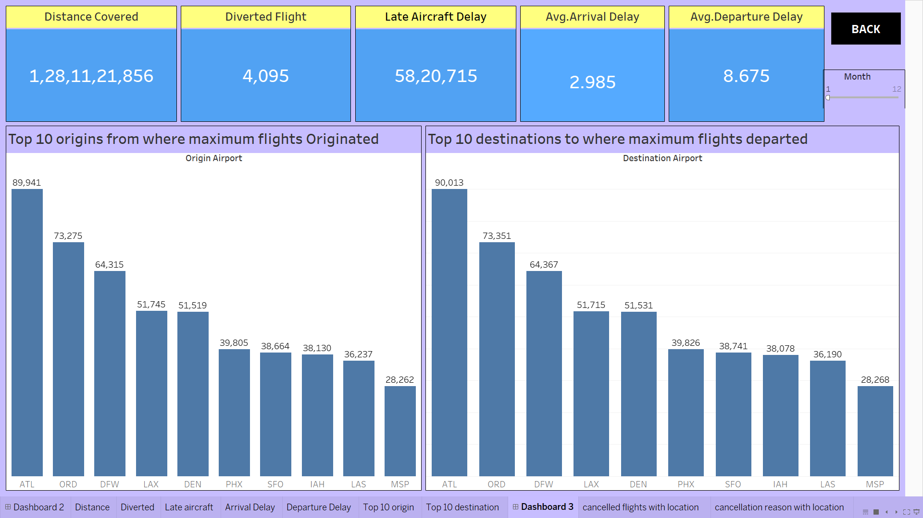
KPI 1st
Used pie chart to calculate the number of flights for weekday & weekend with count of day of week.
In weekday there were maximum flights as compared to weekend. (43 lacs vs15.18 lacs)
Maximum people travelling to & fro from below locations: ATL, ORD, DFW, DEN, LAX, SFO, PHX, IAH, LAS, MSP.
The favourite source & destination location is ATL.

Slide 5
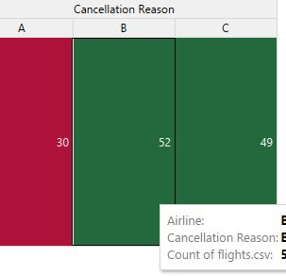
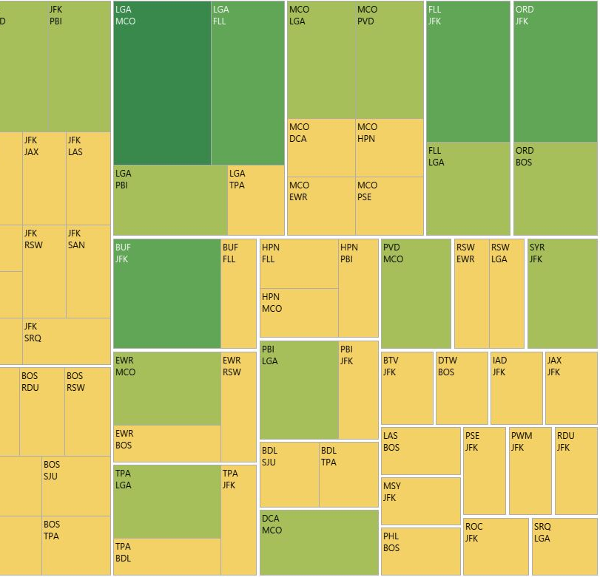
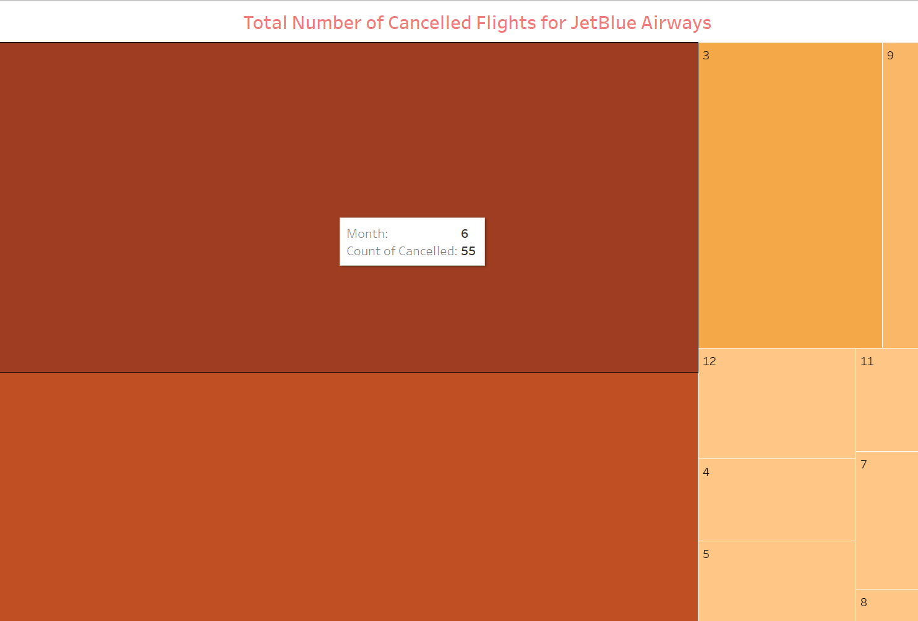
KPI 2nd
For this kpi we used count of cancelled flights with day & airline as filter.
Maximum flights cancelled for June month.
For 1st date of every month the JetBlue Airways flights have been cancelled due to reason A, B, C & D.
Highest Cancelled Flights are due to reason B
Lowest Cancelled Flights are due to reason A
The Cancelled Flights Between two locations for JetBlue Airways are
Highest Cancelled Flights – JFK to BUF ~ 5

Slide 6
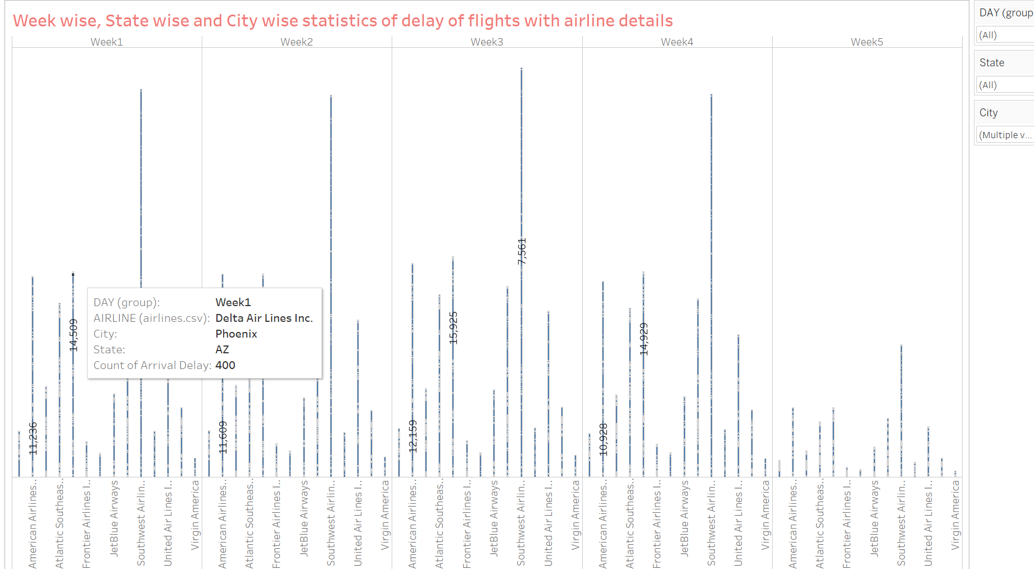
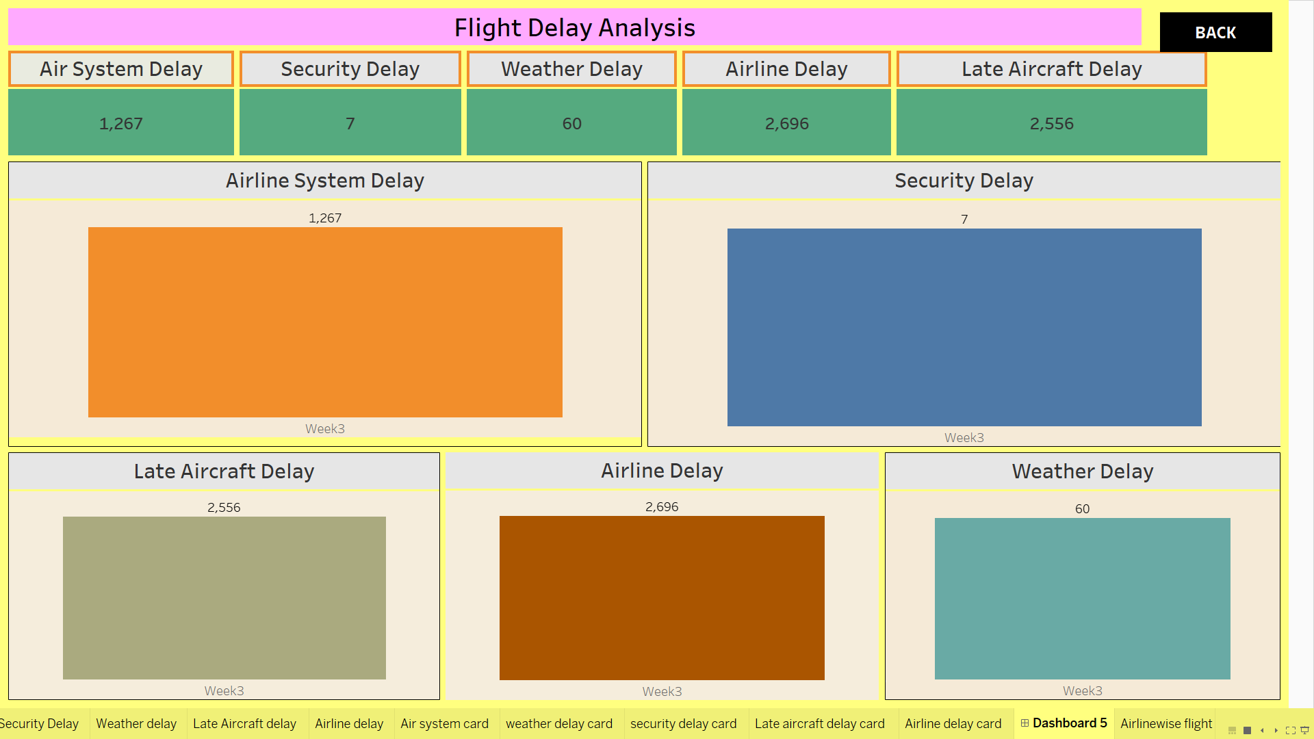
KPI 3rd
For calculating this KPI we used Arrival delay as this is getting affected due to other factors.
The highest overall delay of flights are for southwest airline and lowest for Virgin America Airline.
Maximum delay of flights were in week 3 for Delta Airlines Inc. in Atlanta city & GA state. (51,584 flights)
The factors affecting the arrival delay are Air system delay, security delay, weather delay, airline delay and late aircraft delay.
The total arrival delay has been split into these 5 categories as shown in pic.

Slide 7
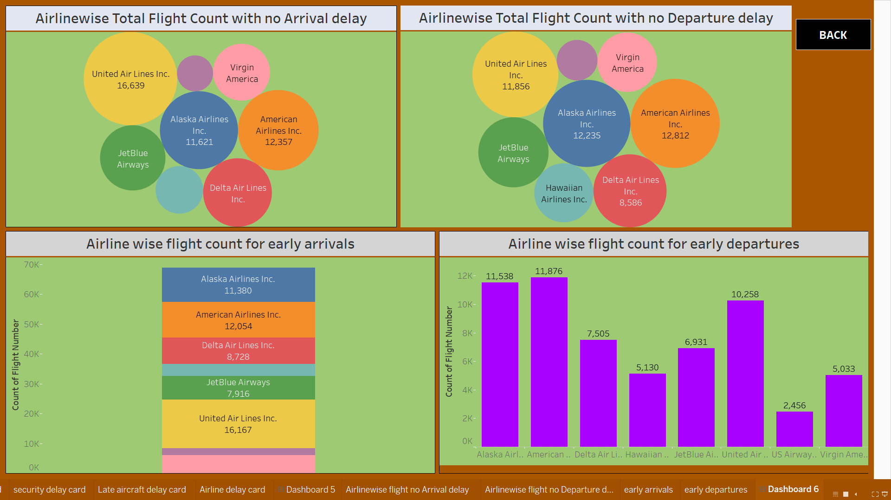
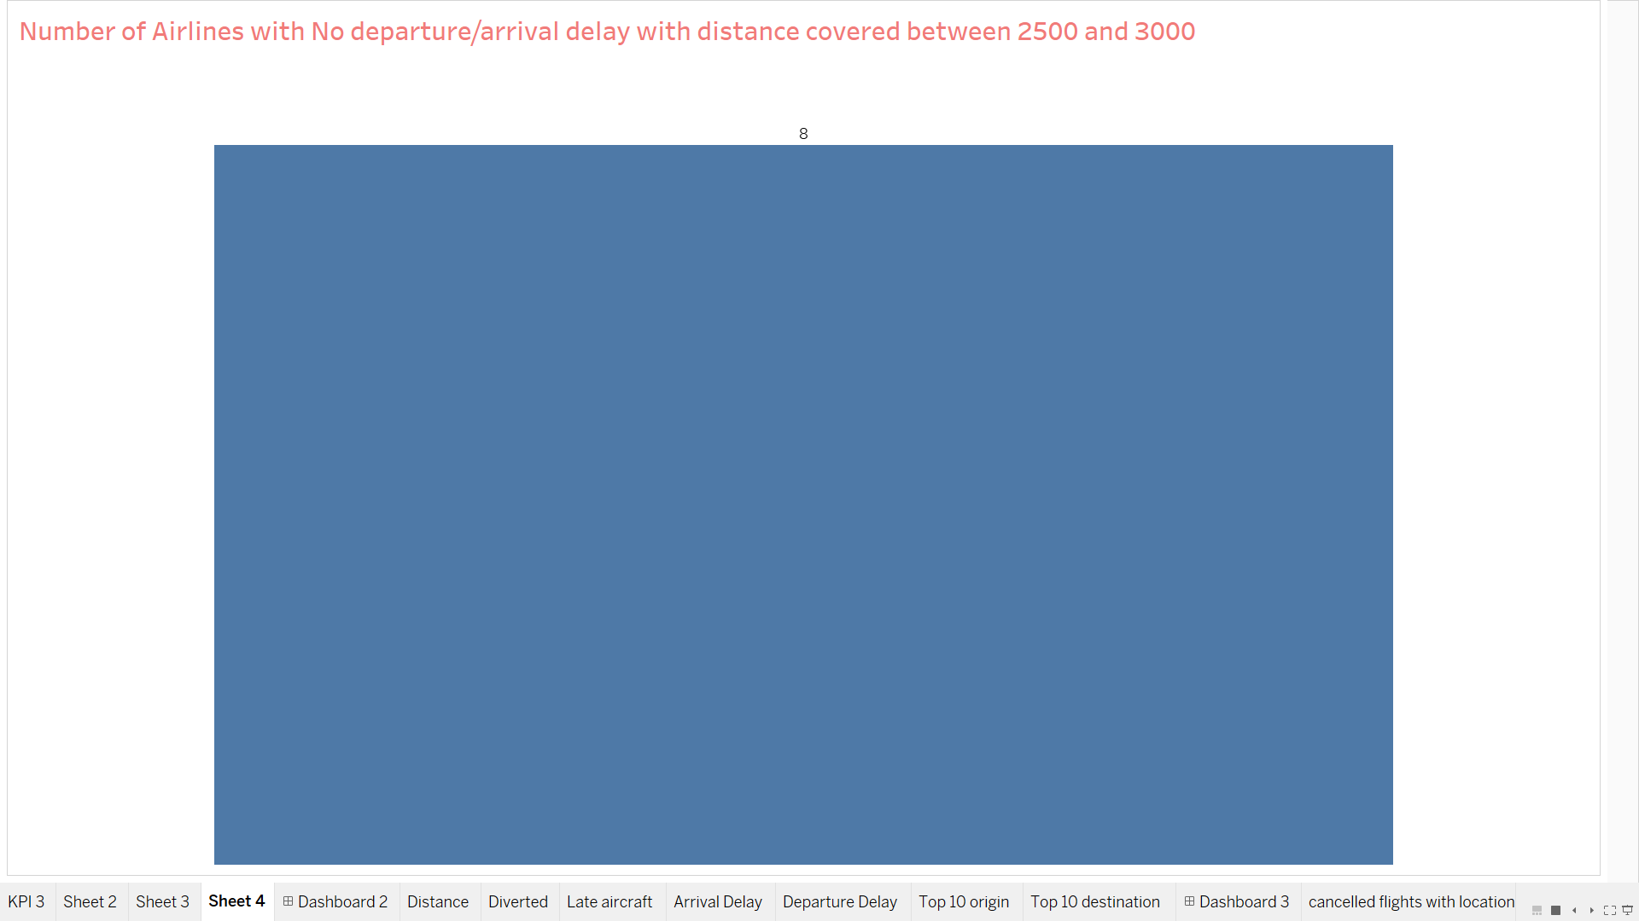
KPI 4th
For this kpi we used count of airlines with distance, arrival and departure delay as filters.
There were 8 airline with no arrival and departure delay with distance between 2500 and 3000.
United airlines having the maximum flights of 16639 with no arrival delay and American Airlines Inc. with 12812 flights with no departure delay.
US airways Inc. having the minimum flights of 2474 with no arrival delay and 2663 with no departure delay.
United Airlines also having more flights with early arrivals and American airlines with early departure.

Slide 8
Thank You

